Slide 1
CUHK CTF Training Camp Web 0x00
Zeddy

Slide 2
Generic CTF Introduction

Slide 3
Type of competition
Jeopardy
Problem solving
Traditional, find flag and submit
First/Second/Third blood have bonus
Fixed point/Dynamic point
AWD(Attack With Defence)
Real-world, very competitive, not friendly to beginner
Need comprehensive ability, e.g. server maintenance, trojan/virus/anti-trojan/anti-virus skill
Speed is everything
Also challenge to organizer, e.g. CISCN 2020 Server down for a whole day, even escape VM.

Slide 4
What a Jeopardy CTF looks like
https://capturetheflag.withgoogle.com/challenges/
Annoucemnts
Chat
Hints
WriteUp: WP/WU
Challenge type: Given a system/middleware/any with old version which has severe known CVE(vulnerability), you need to implement the principle to crack the system.

Slide 5
What a AWD CTF looks like
DEF CON CTF 2018 Finals: https://youtu.be/RXgp4cDbiq4?si=lB4o2tLOnRcknIfJ
Koh(King of Hill): a recent new CTF mode
DEFCON CTF 2023 Final safebox
https://discord.com/channels/1032183712873467954/1140058749218869259/1140062002627231814

Slide 6
How to Learn CTF?

Slide 7
How to Learn CTF?
Not To Learn CTF
Learn CyberSecurity through CTF
And Not Only CTF

Slide 8
How to Learn CTF?
Not To Learn CTF
Learn CyberSecurity through CTF
And Not Only CTF
CTF ≈ Exam/Test
CTF ≈ Intelligence Competition
CTF ≠ Cyber Security
CyberSecutiy
CTF

Slide 9
How to Learn Cyber Security?
Build your information source
e.g. collect as much as possible rss resource
what is rss?
follow some twitter stars
Build your knowledge database
e.g. build a blog/website
e.g. how many ways you know to read a file on Linux except `cat`?
Keep learning
All roads lead to Rome: learn not only intended solution but also other unintended solutions
Notes:
Really Simple Syndication

Slide 10
Some Terms
PoC: Proof of Concept
exp: Exploit
n-day: search on github/google/etc. Find exp and one click
1-day: search for detail, usually no Exp but only PoC, modify to exploit the system
0-day: Try your luck
Notes:
0day for well-known system values a lot of money....
Generally, 0day only for not well-known system, mostly some unknown CMS written by someone

Slide 11
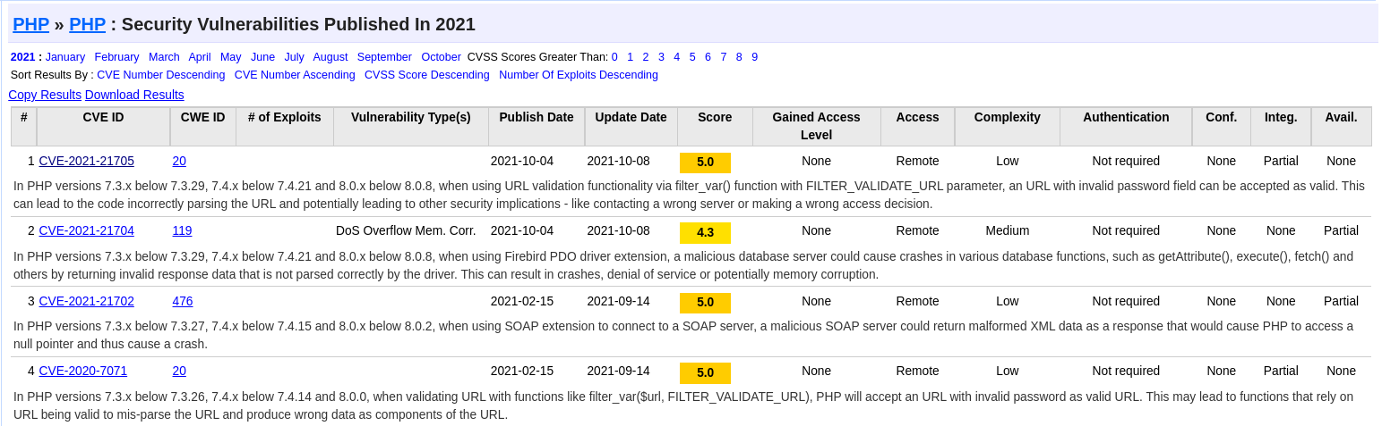
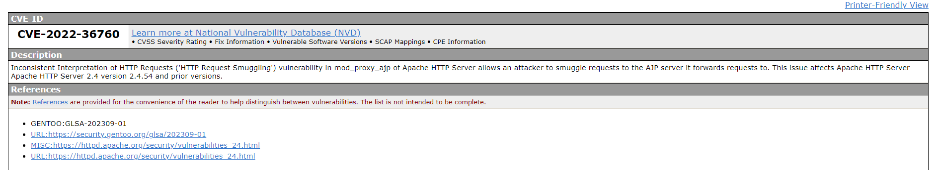
CVE
Common Vulnerabilities and Exposures
Notes:
The Common Vulnerabilities and Exposures (CVE) system provides a reference method for publicly known information security vulnerabilities and exposures.
The United States' National Cybersecurity FFRDC, operated by The MITRE Corporation, maintains the system, with funding from the US National Cyber Security Division of the US Department of Homeland Security.
Considering a specific vulnerability in isolation is hard because there exist many pieces of software, oftentimes with many vulnerabilities and possibly of various types. CVE Identifiers assign each vulnerability a unique formal name, thus establishing a common-language.

Slide 12
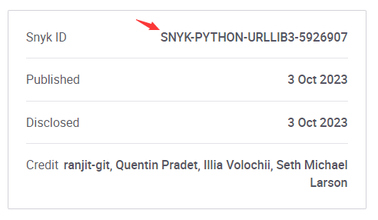
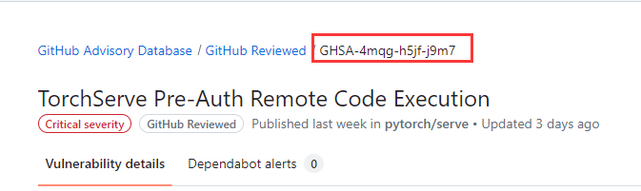
Other CVEs
Not only CVE, but also NVD/CNVD/Snyk-id/GHSA…

Slide 13
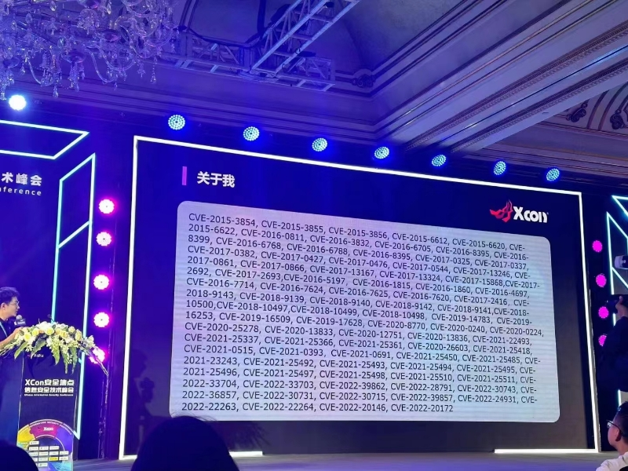
CVE

Slide 14
What we can get from CTF
CyberSecurity Knowledge
Learn from WriteUp
Interesting CS tricks
e.g. how many ways you know to read a file without `cat`
Opportunities to travel to other countries/regions
Money
Friendship
Maybe a boyfriend/girlfriend

Slide 15
What is Web Security?

Slide 16
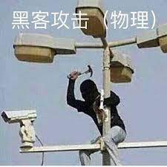
What is Web Security?
Camera Hackers?

Slide 17
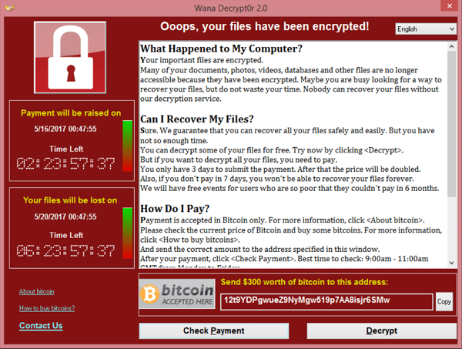
What is Web Security?
Ransomware
How to pay hackers safely?

Slide 18
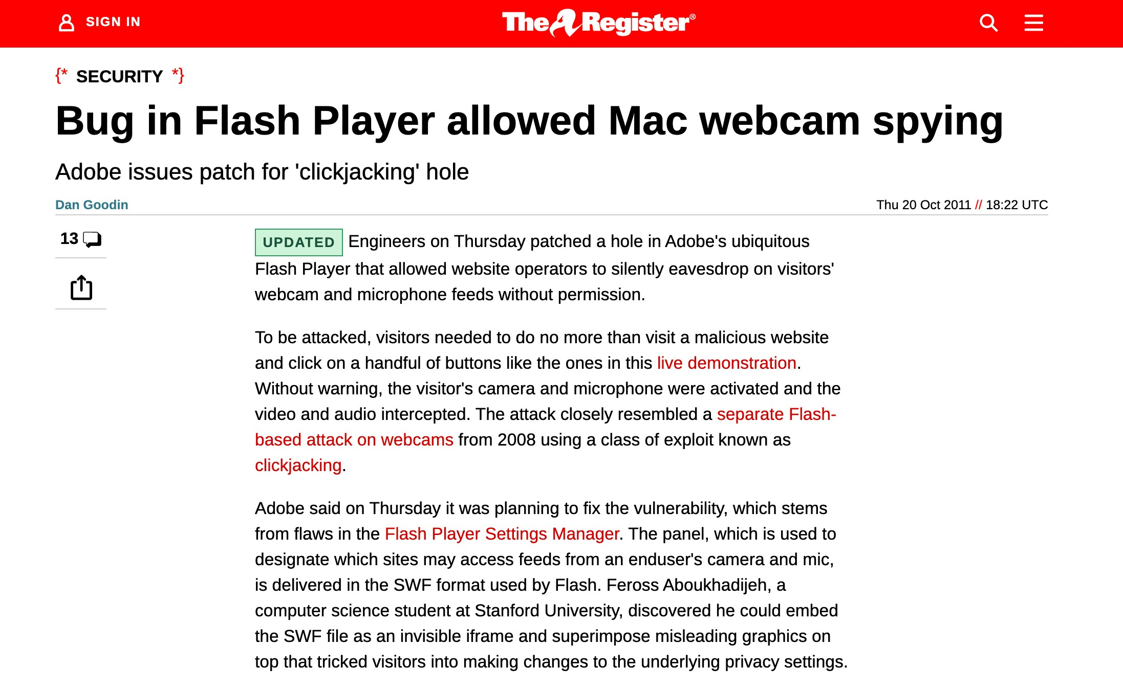

Slide 19
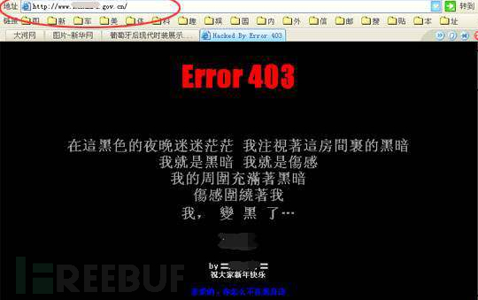

What is Web Security?
https://www.zsxsoft.com/test404.html

Slide 20
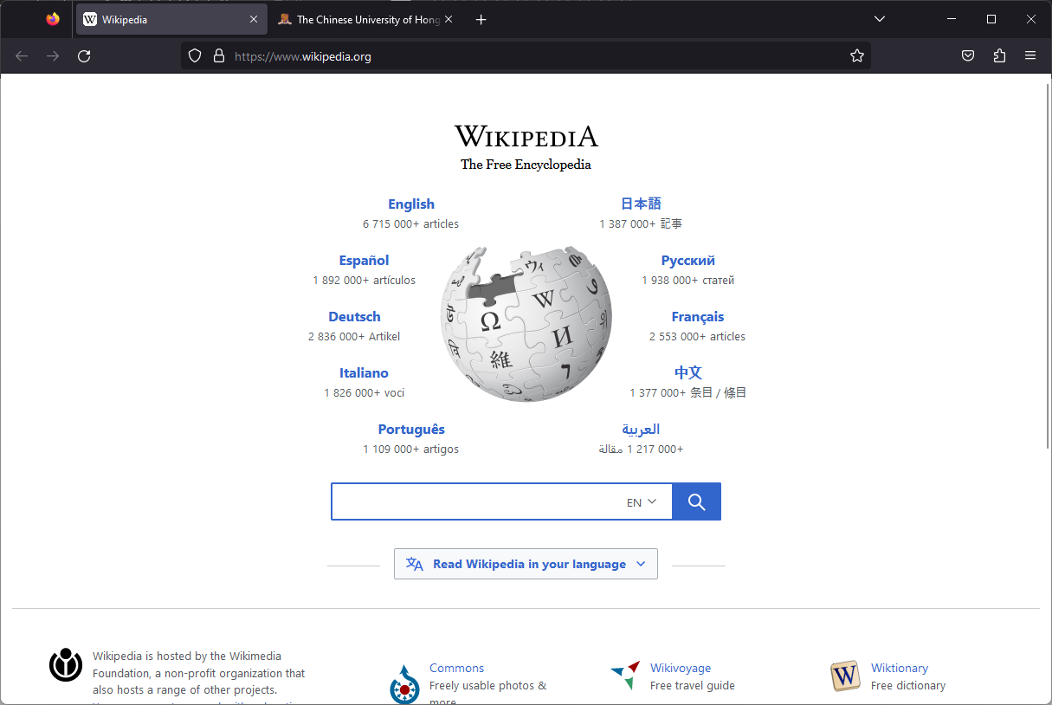

Slide 21
What is Web Security?
Browser security
e.g. Same Origin Policy – Isolate sites from each other, while running in the same browser

Slide 22
What is Web Security?
curl
-d '{"user":"Alice", "permission":"admin"}'
-h "Content-Type: application/json"
-X POST http://example.com/data

Slide 23
What is Web Security?
Server-side security
Attackers can run arbitrary HTTP clients; can send anything to server

Slide 24
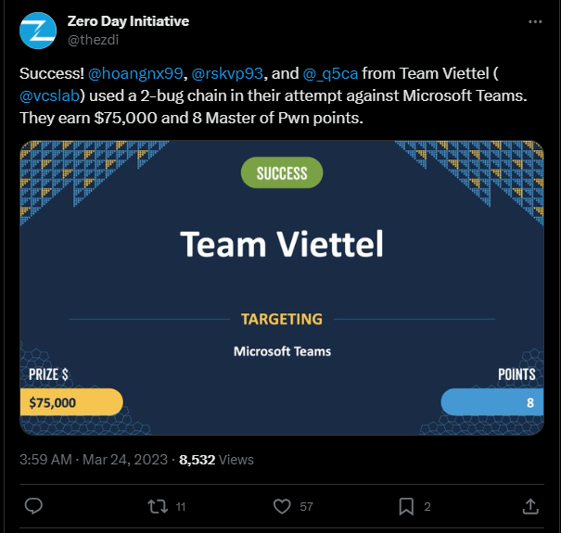
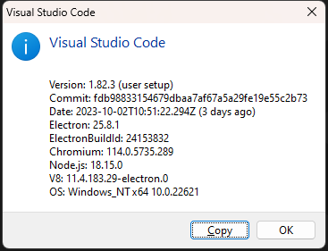
What is Web Security?

Slide 25
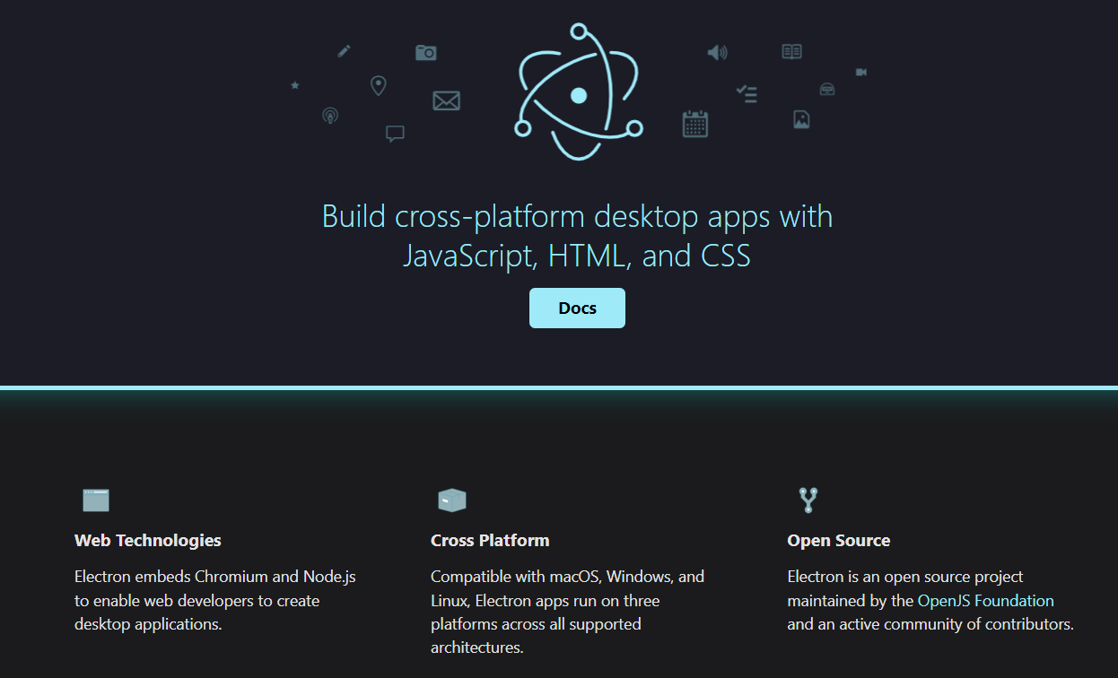
What is Web Security?

Slide 26
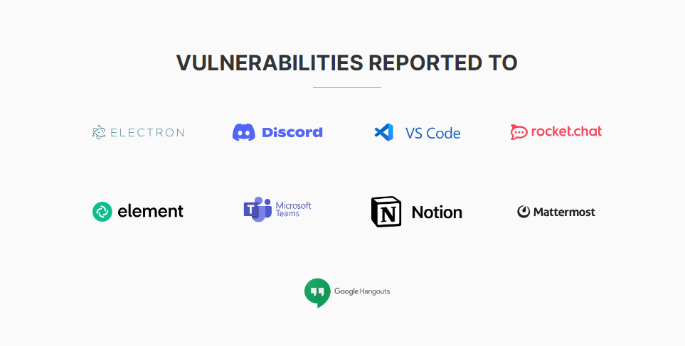
What is Web Security?

Slide 27
What is Web Security?
Client-side security
Prevent user from being attacked while using web app locally

Slide 28
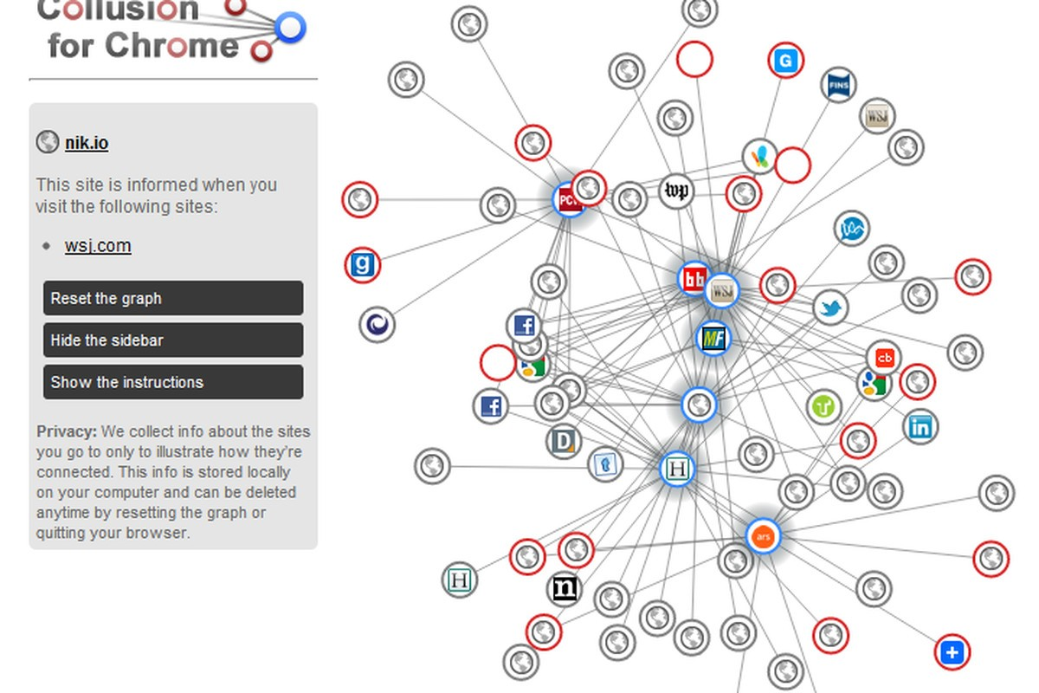
What is Web Security?
Protect the user
From social engineering
From trackers, private data being leaked

Slide 29
What is Web Security?
Protect the user
From social engineering
From trackers, private data being leaked

Slide 30
What is Web Security?
https://github.com/feross/theannoyingsite.com

Slide 31
What is Web Security?
Google “Web Security Mindmap”

Slide 32
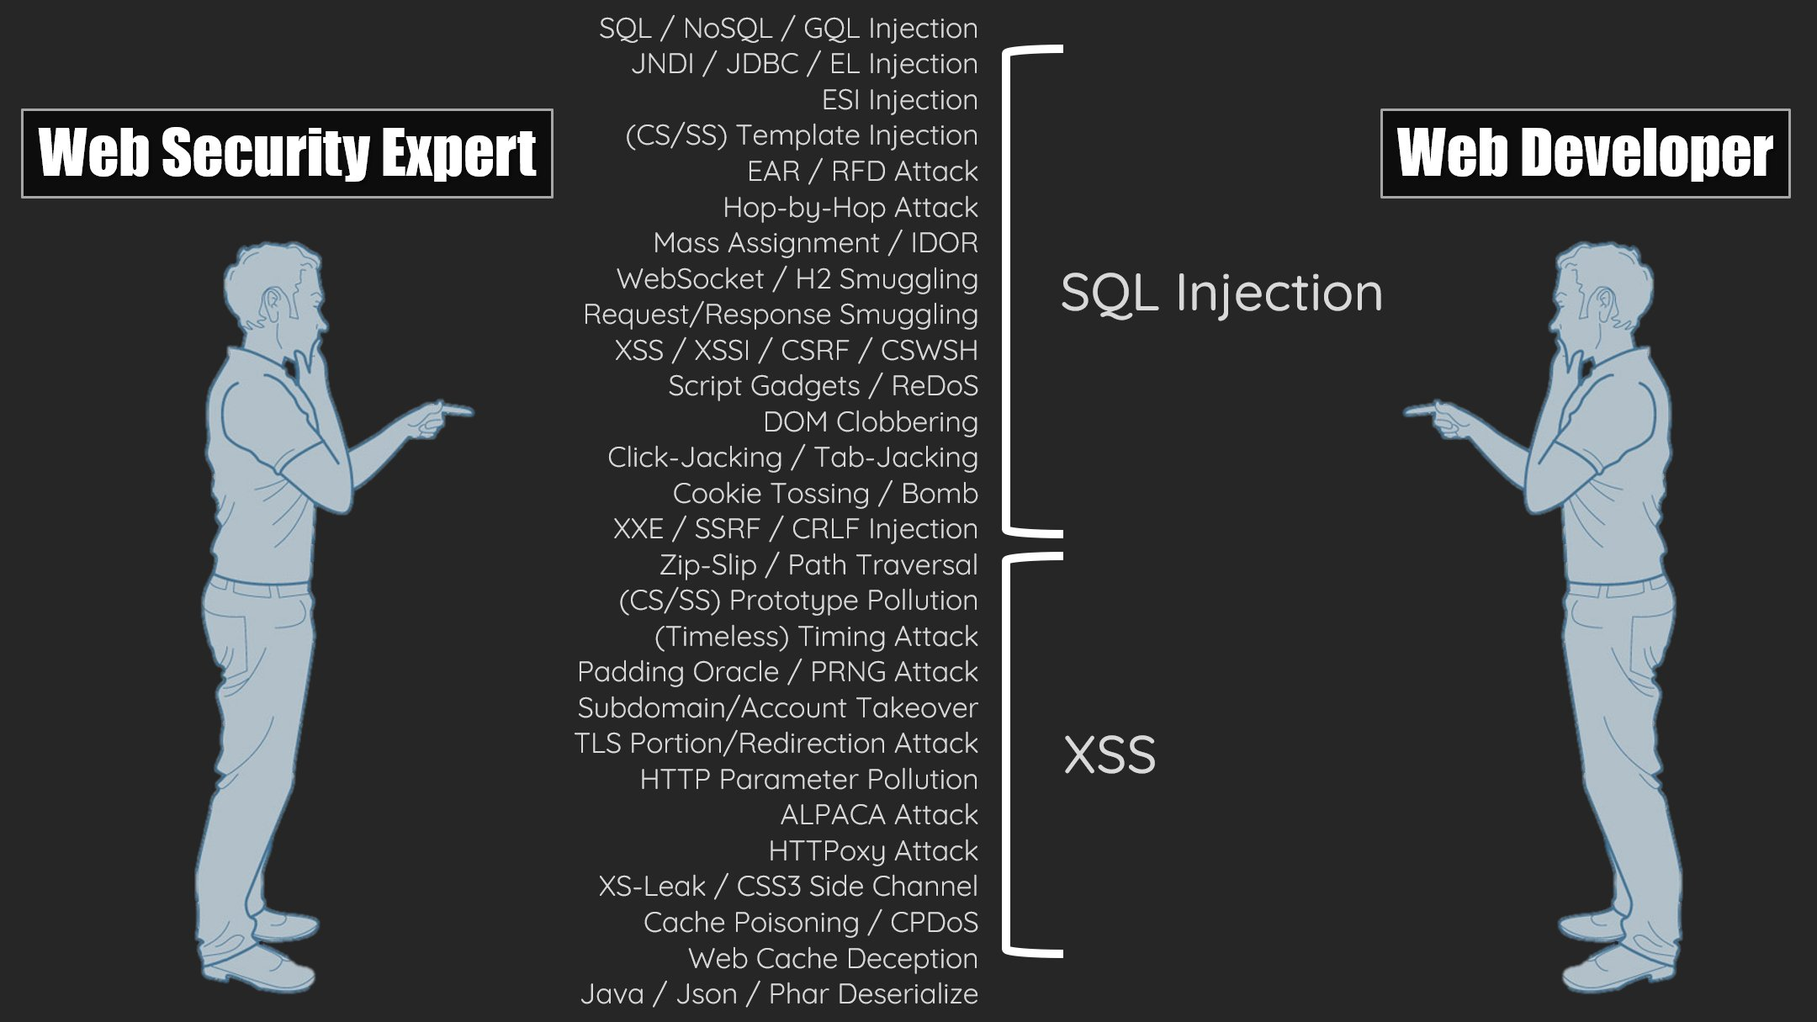
What is Web Security?

Slide 33
Basic Knowledge

Slide 34
HTML
How to Meet Ladies
HTML: HyperText Markup Language

Slide 35
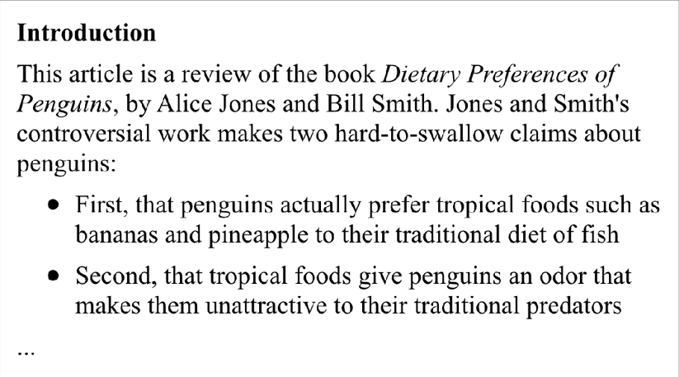
HTML

Slide 36
HTML
<!doctype html>
<html lang='en'>
<head>
<meta charset='utf-8' />
<title>Dietary Preferences of Penguins</title>
</head>
<body>
<h1>Introduction</h1>
<p>
This article is a review of the book Dietary Preferences...
</p>
</body>
</html>

Slide 37
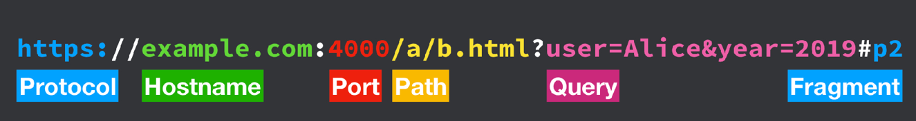
Uniform Resource Locators (URLs)

Slide 38
What happens when you type a URL and press enter?

Slide 39
Domain Name System

Slide 40
DNS
Client
DNS Server
cuhk.edu.hk

Slide 41
DNS
Client
DNS Server
cuhk.edu.hk
27.126.235.25

Slide 42
How does DNS work

Slide 43
DNS
Root NameServer
google.com.?
Client
DNS Recursive Resolver
google.com.

Slide 44
DNS
Root NameServer
google.com.?
See “.com” NS
Client
DNS Recursive Resolver
google.com.

Slide 45
DNS
Root NameServer
google.com.?
See “.com” NS
Client
DNS Recursive Resolver
google.com.?
google.com.
“.com”
NameServer

Slide 46
DNS
Root NameServer
google.com.?
See “.com” NS
Client
DNS Recursive Resolver
google.com.?
google.com.
“.com”
NameServer
See “google.com” NS

Slide 47
DNS
Root NameServer
google.com.?
See “.com” NS
Client
DNS Recursive Resolver
google.com.?
google.com.
“.com”
NameServer
See “google.com” NS
google.com.?
“google.com”
NameServer

Slide 48
DNS
Root NameServer
google.com.?
See “.com” NS
Client
DNS Recursive Resolver
google.com.?
google.com.
“.com”
NameServer
See “google.com” NS
google.com.?
“google.com”
NameServer
8.8.8.8

Slide 49
DNS
Root NameServer
google.com.?
See “.com” NS
Client
DNS Recursive Resolver
google.com.?
google.com.
“.com”
NameServer
8.8.8.8
See “google.com” NS
google.com.?
“google.com”
NameServer
8.8.8.8

Slide 50
What happens when you type a URL and press enter?
Client asks DNS Recursive Resolver to lookup a hostname (google.com).
DNS Recursive Resolver sends DNS query to Root Nameserver
Root Nameserver responds with IP address of TLD Nameserver (".com" Nameserver)
DNS Recursive Resolver sends DNS query to TLD Nameserver
TLD Nameserver responds with IP address of Domain Nameserver (“google.com" Nameserver)
DNS Recursive Resolver sends DNS query to Domain Nameserver
Domain Nameserver is authoritative, so replies with server IP address.
DNS Recursive Resolver finally responds to Client, sending server IP address (8.8.8.8)

Slide 51
DNS + HTTP
DNS Recursive Resolver
google.com.
Client
8.8.8.8
8.8.8.8
Server

Slide 52
DNS + HTTP
DNS Recursive Resolver
google.com.
Client
8.8.8.8
8.8.8.8
Server
HTTP Request

Slide 53
DNS + HTTP
DNS Recursive Resolver
google.com.
Client
8.8.8.8
8.8.8.8
Server
HTTP Request
HTTP Response

Slide 54
Make A HTTP Request
curl http://example.com
curl http://example.com > example.html
open example.html

Slide 55
HTTP Request
HTTP Path
HTTP Protocol Version
HTTP Method
GET / HTTP/1.1
Host: example.com
User-Agent: curl/7.68.0
Accept: */*
HTTP Headers

Slide 56
HTTP Response
HTTP Protocol Version
HTTP Status
HTTP/1.1 200 OK
Content-Length: 9001
Content-Type: text/html; charset=UTF-8 Date: Tue, 24 Sep 2019 20:30:00 GMT
<!DOCTYPE html ...
HTTP Headers
HTTP Body

Slide 57
HTTP Protocol
Client-server model - Client asks server for resource, server replies
Simple - Human-readable text protocol
Extensible - Just add HTTP headers
Stateless - Two requests have no relation to each other

Slide 58
HTTP is stateless?
Obviously, we interact with "stateful" servers all the time
"Stateless" means the HTTP protocol itself does not store state
If state is desired, is implemented as a layer on top of HTTP

Slide 59
Useful HTTP request headers
Host - The domain name of the server (e.g. example.com)
User-Agent - The name of your browser and operating system
Referer - The webpage which led you to this page (misspelled)
Cookie - The cookie server gave you earlier; keeps you logged in
Range - Specifies a subset of bytes to fetch

Slide 60
Make A HTTP Request with headers
curl https://www.cuhk.edu.hk --header "Accept-Language: zh" -v
curl https://www.cuhk.edu.hk --header "Accept-Language: en" -v

Slide 61
Network Model(Simple)
HTML
JS
CSS
HTTP
TLS
TCP
IP

Slide 62
Network Model(Simple)
HTML
JS
CSS
HyperText Transfer Protocol
Transport Layer Security
Transmission Control Protocol
Internet Protocol

Slide 63
Network Model(Simple)
HTML
JS
CSS
HyperText Transfer Protocol
Transport Layer Security
Domain Name System(DNS)
Transmission Control Protocol
User Datagram Protocol(UDP)
Internet Protocol

Slide 64
What happens when you type a URL and press enter?
Perform a DNS lookup on the hostname (example.com) to get an IP address (1.2.3.4)
Open a TCP socket to 1.2.3.4 on port 80 (the HTTP port)
Send an HTTP request that includes the desired path (/)
Read the HTTP response from the socket
Parse the HTML into the DOM
Render the page based on the DOM
Repeat until all external resources are loaded:
If there are pending external resources, make HTTP requests for these (run steps 1-4)
Render the resources into the page

Slide 65
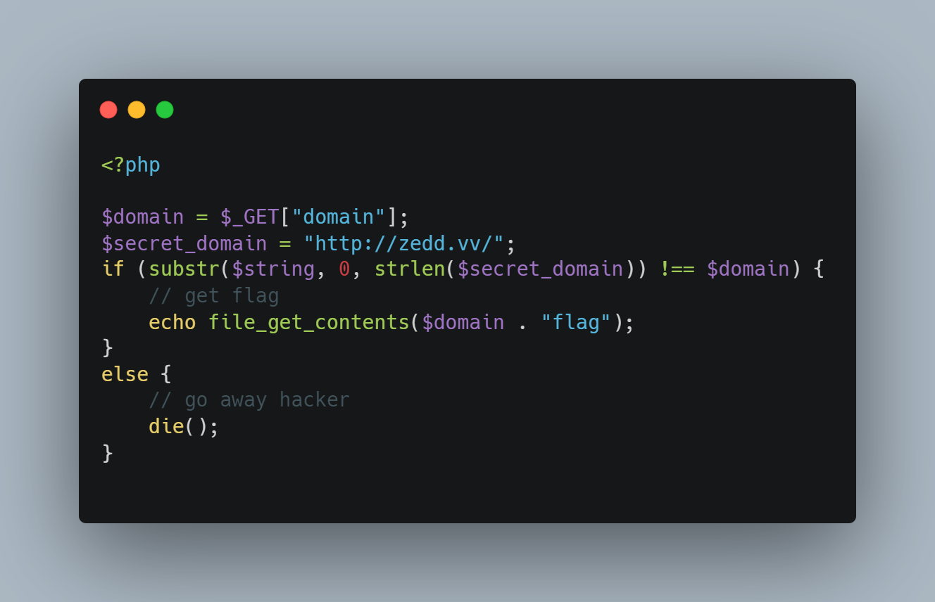
A Small Challenge
Notes:
$_get
Underline

Slide 66
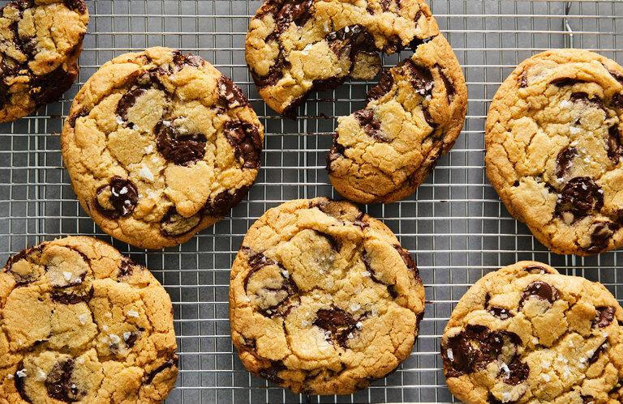
Cookie

Slide 67
Server sends a cookie with a response
HTTP Header Name
Cookie Name
Cookie Value
Set-Cookie: theme=dark;

Slide 68
Client sends a cookie with a request
HTTP Header Name
Cookie Name
Cookie Value
Cookie: theme=dark;

Slide 69
Sessions
Cookies are used by the server to implement sessions
Goal: Server keeps a set of data related to a user's current "browsing session“
Examples
Logins
Shopping carts
User tracking

Slide 70
Quick primer: Signature schemes
Triple of algorithms (G, S, V)
G() → k - generator returns key
S(k, x) → t - signing returns a tag t for input x
V(k, x, t) → accept|reject - checks validity of tag t for given input x

Slide 71
Client
Server

Slide 72
Client
Server
G()->k

Slide 73
Client
Server
G()->k
POST /login HTTP/1.1
Username=alice&password=password

Slide 74
Client
Server
G()->k
POST /login HTTP/1.1
Username=alice&password=password
Login info ok?

Slide 75
Client
Server
G()->k
POST /login HTTP/1.1
Username=alice&password=password
Login info ok?
OK!

Slide 76
Client
Server
G()->k
POST /login HTTP/1.1
Username=alice&password=password
Login info ok?
OK!
S(k, ‘alice’) -> t

Slide 77
Client
Server
G()->k
POST /login HTTP/1.1
Username=alice&password=password
Login info ok?
OK!
HTTP/1.1 200 OK
Set-Cookie: username=alice;
Set-Cookie: tag=t;
S(k, ‘alice’) -> t

Slide 78
Client
Server
G()->k
POST /login HTTP/1.1
Username=alice&password=password
Login info ok?
OK!
HTTP/1.1 200 OK
Set-Cookie: username=alice;
Set-Cookie: tag=t;
S(k, ‘alice’) -> t
GET / HTTP/1.1
Cookie: username=alice; tag=t;

Slide 79
Client
Server
G()->k
POST /login HTTP/1.1
Username=alice&password=password
Login info ok?
OK!
HTTP/1.1 200 OK
Set-Cookie: username=alice;
Set-Cookie: tag=t;
S(k, ‘alice’) -> t
GET / HTTP/1.1
Cookie: username=alice; tag=t;
V(k, ‘alice’, t) -> ok?

Slide 80
Client
Server
G()->k
POST /login HTTP/1.1
Username=alice&password=password
Login info ok?
OK!
HTTP/1.1 200 OK
Set-Cookie: username=alice;
Set-Cookie: tag=t;
S(k, ‘alice’) -> t
GET / HTTP/1.1
Cookie: username=alice; tag=t;
V(k, ‘alice’, t) -> ok?
OK!

Slide 81
Client
Server
G()->k
POST /login HTTP/1.1
Username=alice&password=password
Login info ok?
OK!
HTTP/1.1 200 OK
Set-Cookie: username=alice;
Set-Cookie: tag=t;
S(k, ‘alice’) -> t
GET / HTTP/1.1
Cookie: username=alice; tag=t;
V(k, ‘alice’, t) -> ok?
OK!
HTTP/1.1 200 OK
Private webpage for Alice!

Slide 82
Client
Server
G()->k
POST /login HTTP/1.1
Username=alice&password=password
Login info ok?
OK!
HTTP/1.1 200 OK
Set-Cookie: username=alice;
Set-Cookie: tag=t;
S(k, ‘alice’) -> t
GET / HTTP/1.1
Cookie: username=alice; tag=t;
V(k, ‘alice’, t) -> ok?
Repeat
OK!
HTTP/1.1 200 OK
Private webpage for Alice!

Slide 83
Sessions: Desired properties
Browser remembers user (so user doesn't need to repeatedly log in)
User cannot modify session cookie to login as another user
Session cookies are not valid forever
Sessions can be deleted on the server-side
Sessions should expire after some time, e.g. 30 days

Slide 84
CTF Tools

Slide 85

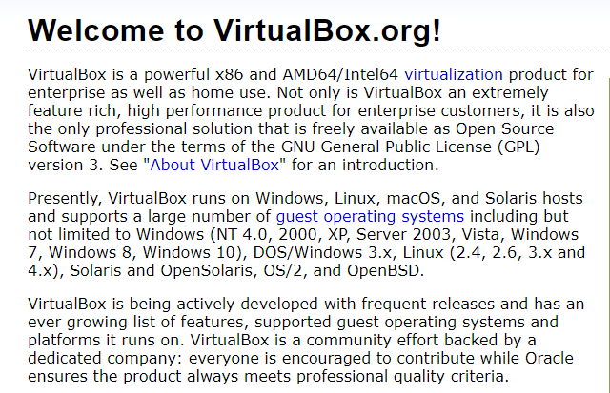
Virtual Machine
Notes:
A Virtual Machine (VM) is a compute resource that uses software instead of a physical computer to run programs and deploy apps. One or more virtual “guest” machines run on a physical “host” machine.
emulate

Slide 86
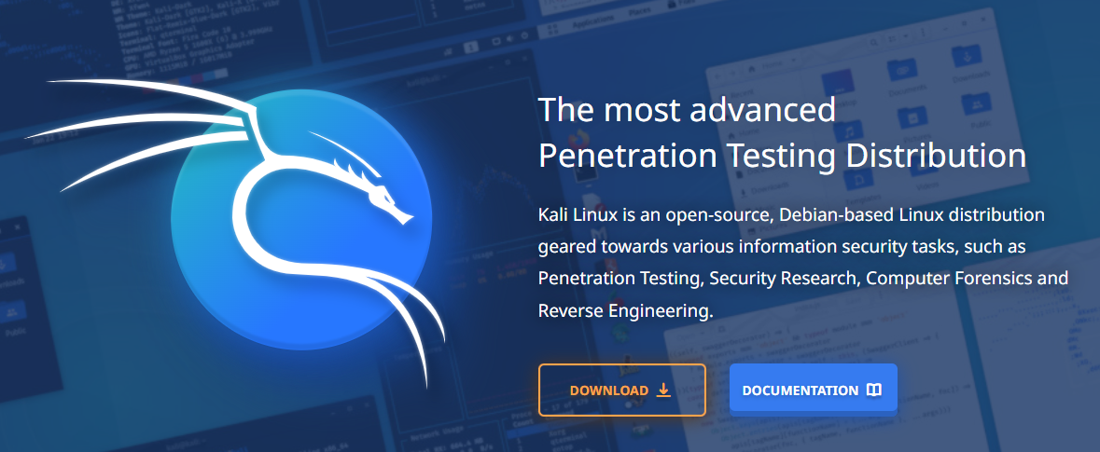
Kali Linux

Slide 87
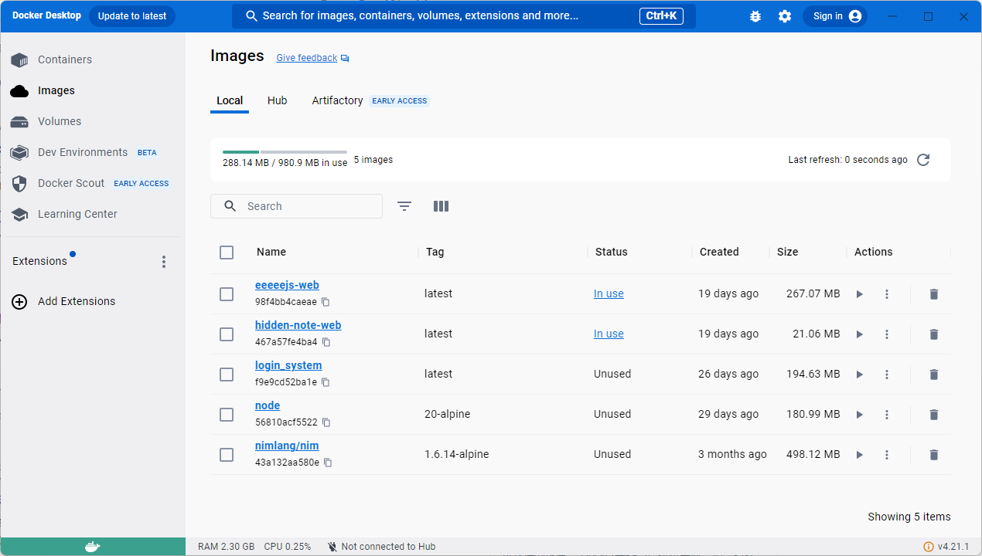
Docker
Notes:
Docker is a set of platform as a service (PaaS) products that use OS-level virtualization to deliver software in packages called containers.
Docker is a tool that is used to automate the deployment of applications in lightweight containers so that applications can work efficiently in different environments in isolation.

Slide 88
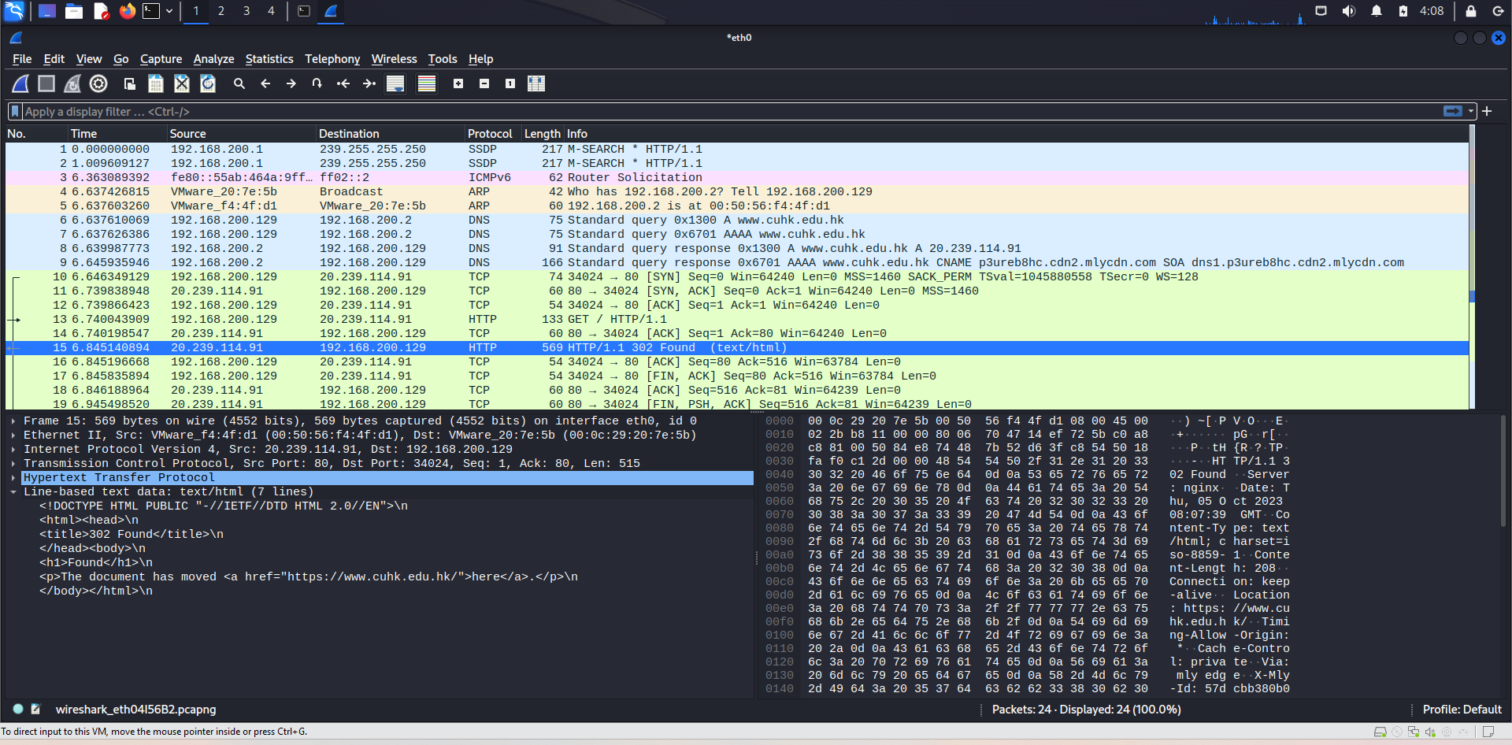
WireShark
Notes:
Wireshark is a network protocol analyzer, or an application that captures packets from a network connection, such as from your computer to your home office or the internet. Packet is the name given to a discrete unit of data in a typical Ethernet network.

Slide 89
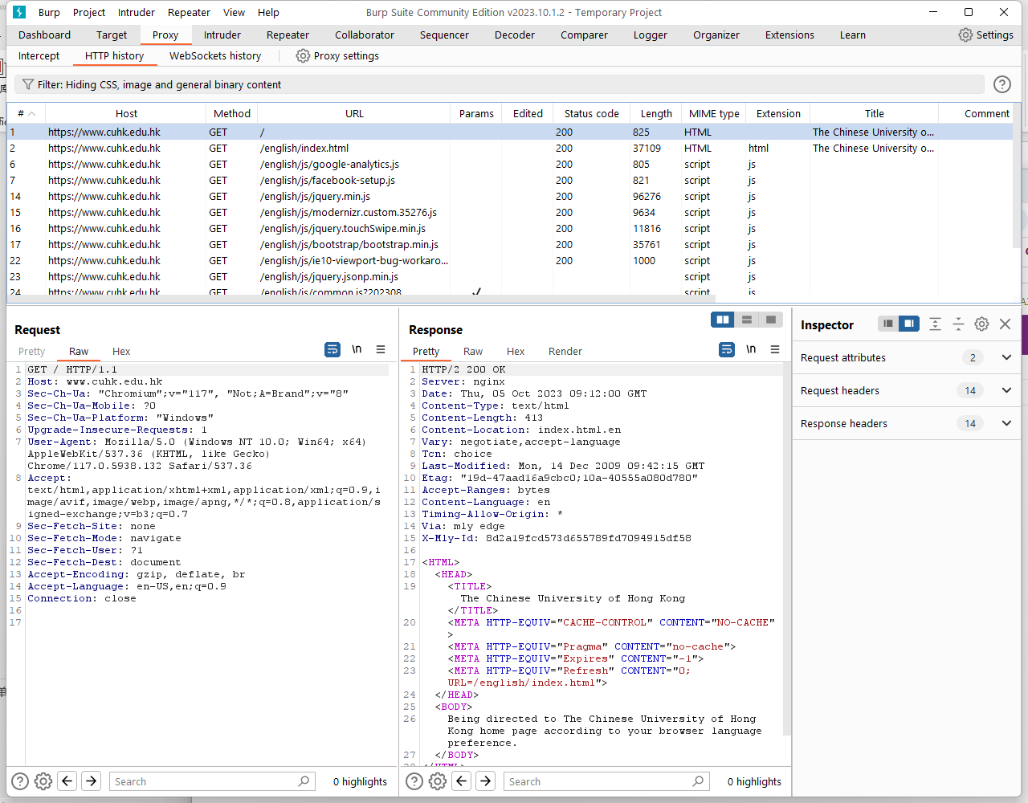
BurpSuite
Notes:
Burp Suite is a software security application used for penetration testing of web applications. Both a free and a paid version of the software are available. The software is developed by the company PortSwigger.[1][2] The suite includes tools such as a proxy server (Burp Proxy), an indexing robot (Burp Spider), an intrusion tool (Burp Intruder), a vulnerability scanner (Burp Scanner) and an HTTP repeater (Burp Repeater).

Slide 90
Challenges Time
Picoctf - GET aHEAD/Insp3ct0r

Slide 91
Credits
Some slides are based on the slides of Standford CS 253 Web Security(https://web.stanford.edu/class/cs253/)

